Slide 1
Course Name : Project Stage I
Course Code:417527
Jarvie: AI-Driven Mental Health Companion
Guide
Mrs. Mayuri Fegade
Group Members
Pratik Deepak Bandpatte [24129]
Neha Raju Medar [24147]
Devesh Narendra Mahajan [24135]
Vishal Ajay Wagh [24126]

Slide 2
Outline
Introduction
Research Gap Identification
Literature Survey
Problem Statement
Motivation/ Scope /Objective
System Architecture
Algorithm
Hardware/Software Requirements
Mathematical Model
Cost Identification
Benefits Of Society
Comparison (Existing System And Proposed System)
Application
Conclusion/Future Scope
Reference

Slide 3
Introduction
In today’s fast-paced world, mental health challenges have become increasingly prevalent, affecting millions globally. Addressing these challenges requires innovative solutions that are accessible, scalable, and effective.
The "AI-Driven Mental Health Companion" project aims to leverage advancements in Artificial Intelligence (AI) and Machine Learning (ML) to create a virtual assistant that supports mental well-being.
This AI-powered companion will utilize Natural Language Processing (NLP) and Generative AI to interact with users, provide emotional support, and offer actionable insights based on real-time sentiment analysis.

Slide 4
Research gap identification
Many mental health services and applications require subscriptions or high fees, making them inaccessible for individuals on tight budgets. The difference our project will identify that AI-driven mental health companion is completely free, providing essential support and resources to users without financial barriers, making mental health care more accessible to everyone.

Slide 5
Literature Review
Sr. No. | Paper Details | Problem Discussion | Algorithm /Technique used | Parameter Consider | Result
1 | Sakhi: AI-Generated Mental Health Companion | Mental health issues like anxiety, stress, and isolation are on the rise. Sakhi is developed to provide emotional support through an AI-driven chatbot, offering empathetic responses and mental health resources. | Sentiment analysis using LSTM, GPT-2 model for generating responses, TensorFlow framework. | Sentiment accuracy, response coherence, user engagement, and interaction effectiveness. | Sakhi provides an 89% accuracy rate for sentiment detection and 85% user satisfaction, with users reporting significant emotional relief through interaction.
2 | Chatbot for Mental Well-being | The project aims to create a 24/7 generative chatbot for emotional expression and stress relief, enabling users to track their mood over time. | It employs an SVM classifier for mood detection and a Seq2Seq model with RNNs for generating responses based on tokenized input. | The system uses user mood from the SVM classifier and tokenized input vectors, with an attention mechanism to improve response generation. | The Seq2Seq model achieved 96.53% accuracy and 90.69% validation accuracy after 30 epochs, providing a user-friendly interface for mood classification and response generation.
Department of Artificial Intelligence and Data Science

Slide 6
Sr. No. | Paper Details | Problem Discussion | Algorithm /Technique used | Parameter Consider | Result
3 | MOODIFY: Tailored, Personal, and Multifaceted AI Assistant for Young Adult Mental Health Issues | MOODIFY addresses increasing anxiety and stress levels among young adults by offering personalized, data-driven advice and emotional support.. | Fine-tuned BERT model for sentiment analysis, Transformer architecture for response generation, TensorFlow for backend development. | Sentiment prediction, response accuracy, personalization capability, user satisfaction metrics. | Achieved 93% accuracy in sentiment detection and 88% user satisfaction, providing tailored emotional support that resonated well with young adults.
4 | EMPATH.AI: A Context-Aware Chatbot for Emotional Detection and Support | EMPATH.AI focuses on emotional detection and offering contextually appropriate responses to users experiencing mental health challenges such as loneliness and depression.. | Sentiment analysis using BERT embeddings, contextual response generation via Seq2Seq with an attention mechanism.. | Sentiment accuracy, contextual relevance, response latency, user satisfaction. | The chatbot demonstrated 95% accuracy in emotional detection and 86% user satisfaction, with improvements noted in contextual understanding and empathetic response generation.
Department of Artificial Intelligence and Data Science

Slide 7
Problem Statement
Despite increasing awareness of mental health issues, many people encounter barriers to accessing timely and personalized support due to limitations in traditional services. This project aims to address these challenges by developing an AI-powered mental health companion that uses advanced natural language processing to offer real-time and empathetic support, thereby improving access to mental health support and enhancing overall well-being.

Slide 8
Motivation / Scope / Objective
Motivation:
Driven by the growing need for accessible mental health resources, this project aims to leverage AI to provide continuous, personalized support that overcomes barriers like cost, availability, and stigma.
Scope & Objective:
The scope of this project is to create an AI-driven mental health companion designed to offer personalized emotional support and relevant resources to users.
By utilizing advanced NLP techniques, the project aims to enhance user interaction through accurate and empathetic responses.
The initiative focuses on improving accessibility to mental health resources and providing guidance, without substituting professional mental health services.

Slide 9
System Architecture
Text Pre-Processing
User Input
Feature Extraction
Sentiment Analysis
API
User
Response Output
Response Generation
Feedback Collection
Chatbot
System Architecture of AI driven Mental Health Companion

Slide 10
Algorithms
1. NLP Algorithm:
Support Vector Machines (SVM)
BERT
LSTM
GPT
2. Machine Learning Algorithms:
Q-Learning
Recommendation Algorithms
Content-Based Filtering
TF-IDF
3. Behavioural and Predictive Analytics Algorithms:
Convolutional Neural Networks (CNNs)
Recurrent Neural Networks (RNNs)
Transformer Models
4. Data Privacy and Security Algorithms:
AES (Advanced Encryption Standard)
RSA (Rivest–Shamir–Adleman)
Differential Privacy
Department of Artificial Intelligence and Data Science

Slide 11
Software & Hardware Requirements:
1. Software Requirements:
Windows/Ubuntu OS
Python3 and suitable IDE
Flask/ Django, Required Libraries
3. Database Requirements:
MySQL/ MongoDB
2. Hardware Requirements:
i5 Processor
256 SSD/1TB HDD
8GB RAM
GPU 4GB VRAM with CUDA support.
Department of Artificial Intelligence and Data Science

Slide 12
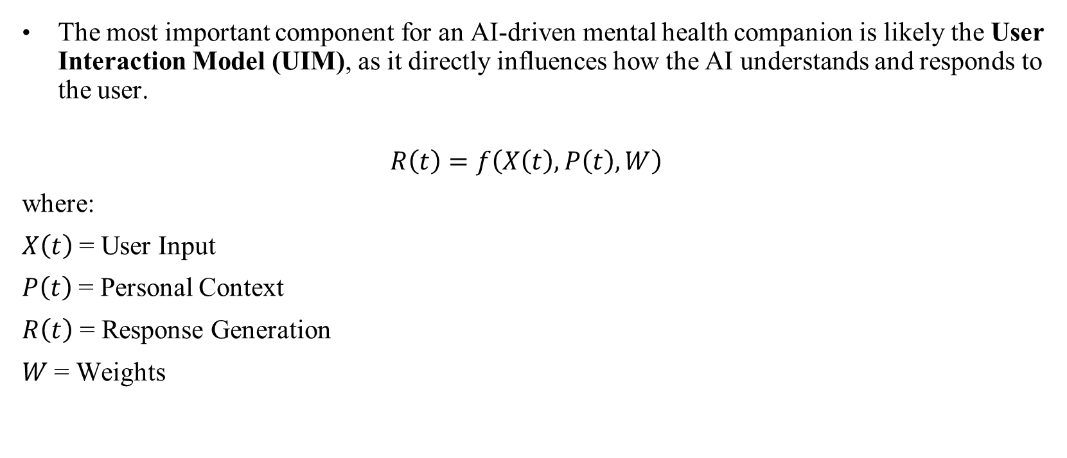
Mathematical Model

Slide 13
Cost Identification
Requirements | Cost Estimated
Hardware | Estimated cost: ₹30,000 - ₹50,000 (if a new development machine is needed).
Software | API costs (such as OpenAI or Hugging Face) may incur for production-level use. Estimated cost for API access: ₹5,000 - ₹10,000 per month (depending on usage).
Database | Cloud database solutions such as Firebase, AWS RDS, or PostgreSQL on Heroku. Estimated cost: ₹2,000 - ₹5,000 per month for basic usage.
Internet(WiFi) | Estimated cost: ₹1,000 - ₹2,000 per month (assuming home WiFi).
Man Power | Based on the number of developers (1-2) working for 3-6 months.
Total | Estimated total cost: ₹60,000 - ₹80,000 (including hardware, software, and operational costs).

Slide 14
Benefits of Society
AI companions can provide support at any time, making mental health resources accessible to individuals who may not have access to traditional services due to time constraints or geographical limitations.
They can serve a large number of users simultaneously, helping to bridge the gap in mental health care where human resources are limited, thus addressing the growing demand for mental health services.
AI companions allow users to seek help in a private setting, reducing the stigma often associated with traditional therapy. This encourages more individuals to engage in mental health care without fear of judgment.

Slide 15
Comparison of Existing System with Propose System
Existing System | Propose System
An AI-driven chatbot aimed at enhancing mental wellness through self-help techniques and user interaction. An AI-driven chatbot aimed at enhancing mental wellness through self-help techniques and user interaction. | An advanced AI-driven mental health companion that integrates various therapeutic approaches, including CBT, mindfulness, and psychoeducation, to support users holistically. A text-based chatbot designed to deliver mental health support, specifically leveraging cognitive behavioral therapy (CBT) principles.
Highly customizable experience, allowing users to define their avatar and conversation topics, which enhances engagement but may dilute therapeutic focus. | Features advanced adaptive learning that continuously tailors interactions based on user history, preferences, emotional states, and behavioral patterns, ensuring a highly personalized experience.
Implements basic sentiment analysis that can detect general mood changes but may struggle with specific emotional contexts and subtleties in user language. | Utilizes advanced natural language processing (NLP) and emotion detection algorithms that provide nuanced understanding of user emotions, enhancing responsiveness and appropriateness of support.
Designed for general users seeking mental health support, appealing to a wide demographic, including those experiencing mild to moderate distress. | Aims to provide comprehensive mental health support to a diverse audience, addressing a wide range of needs, including those experiencing anxiety, depression, and other mental health challenges, ensuring inclusivity and accessibility.

Slide 16
Applications
AI companions can provide users with instant emotional support through chat or voice interactions, helping them navigate crises, manage anxiety, or cope with stress.
They can also monitor user inputs (like mood tracking) to detect changes in emotional well-being, enabling timely interventions or alerts to human professionals when necessary.

Slide 17
Conclusion
The proposed mental health companion system effectively integrates advanced AI technologies, such as chatbot APIs and sentiment analysis, to provide personalized and supportive mental health responses in real-time.
This approach offers a comprehensive solution for mental health support, providing a scalable framework that can be adapted for various use cases while enhancing user experience and engagement.

Slide 18
References
M. Agarwal, D. Chauhan, N. Yadav and S. Singhal, "Sakhi: AI-Generated Mental Health Companion," 2024 1st International Conference on Innovative Sustainable Technologies for Energy, Mechatronics, and Smart Systems (ISTEMS), Dehradun, India, 2024, pp. 1-6, doi: 10.1109/ISTEMS60181.2024.10560327.
Kumbhar, P.B., Vaidya, O.A., & Kulkarni, K.S. (2024). KrishnaVani: An AI-Powered Companion—Your AI Buddy for Student Mental Health Support. International Journal of Humanities Social Science and Management (IJHSSM), 4(3), 793-799. www.ijhssm.org. Date of Submission: 11-05-2024; Date of Acceptance: 23-05-2024.
N. Kallivalappil, K. D’Souza, A. Deshmukh, C. Kadam and N. Sharma, "Empath.ai: a Context-Aware Chatbot for Emotional Detection and Support," 2023 14th International Conference on Computing Communication and Networking Technologies (ICCCNT), Delhi, India, 2023, pp. 1-7, doi: 10.1109/ICCCNT56998.2023.10306584.
J. Limbachia, Y. Damani, S. Dave and V. Sagvekar, "MOODIFY: Tailored, Personal and Multifaceted AI Assistant for Young Adult Mental Health Issues," 2023 6th International Conference on Advances in Science and Technology (ICAST), Mumbai, India, 2023, pp. 106-110, doi: 10.1109/ICAST59062.2023.10455044.
Booth F, Potts C, Bond R, Mulvenna M, Kostenius C, Dhanapala I, Vakaloudis A, Cahill B, Kuosmanen L, Ennis E. A Mental Health and Well-Being Chatbot: User Event Log Analysis. JMIR Mhealth Uhealth. 2023 Jul 6;11:e43052. doi: 10.2196/43052. PMID: 37410539; PMCID: PMC10360018.

Slide 19

Thank You..!

